Slide 1
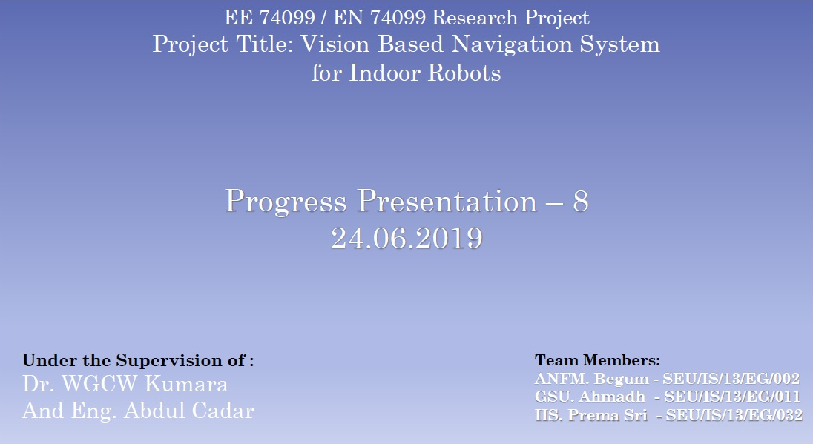

Slide 2
This week we worked on,
Designing Robot model
Total Weight estimation
Idea for Path planning based on External camera
Mapping and Navigation with ROS

Slide 3
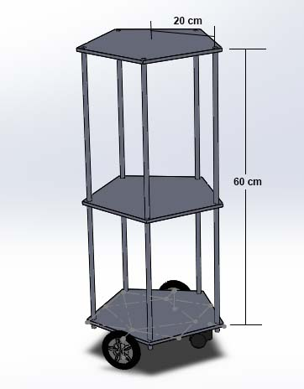
Designing Robot model
We did a Solidworks model for the Robot design we are planning to build.
For the plates we decided to go with Aluminum Composite Material boards because of their strength and light weight.
To connect plates we will be using threaded rods covered by aluminum tubes.

Slide 4
Total Weight Estimation
Item | Weight
ACM Board for 0.378 𝑚² area | 1.52 𝑘𝑔
Threaded rods for 3.5 m | 2.2 kg
Kinect | 0.6 kg
Aluminum tubes | 0.4 kg
Wheels | 0.6 kg
Power Bank and Battery | 1.0 kg
Motors (NEMA 23) x 2 | 1.4 kg
Other Electronics | 0.5 kg
For foods | 1.0 kg
Total Weight | 9.22 kg

Slide 5
Calculation of motor torque
In our design we have 4 wheels and 2 motors.
Here we assume that the coefficient of friction is 0.6 and radius of wheel is 5 cm.
The weight acting on the four wheels can be written as,
N1 is the weight acting on each caster wheel.
N2 on each motor wheel.
$$\text{2 ∗ }\text{N}\text{1 + 2 ∗ }\text{N}\text{2 = }\text{Total} \text{Weight}$$
The maximum torque is required when the robot starts moving. It should also overcome friction.
To calculate the maximum torque (T),
$$\text{μ}\text{ ∗ }\text{N}\text{ ∗ }\text{r}\text{ − }\text{T}\text{ = 0}$$
μ is the coefficient of friction.
N is the average weight acting on each wheel.
r is the radius of wheels.
T is the torque.

Slide 6
Calculation of motor torque
Assuming that the weight of the robot is equally distributed on all the four wheels,
$$\text{N} \text{=} \text{mg}\text{ / 4}$$
$=9.22 kg ×9.8{ms}^{−2}$ / 4
$$=22.6 N$$
Motor torque required,
$\text{T} \text{=} \text{0.6 ∗ }\text{22.6}\text{N}\text{ ∗ 0.05}$ m
$\text{=} \text{0.6}\text{78 }\text{N}$m

Slide 7
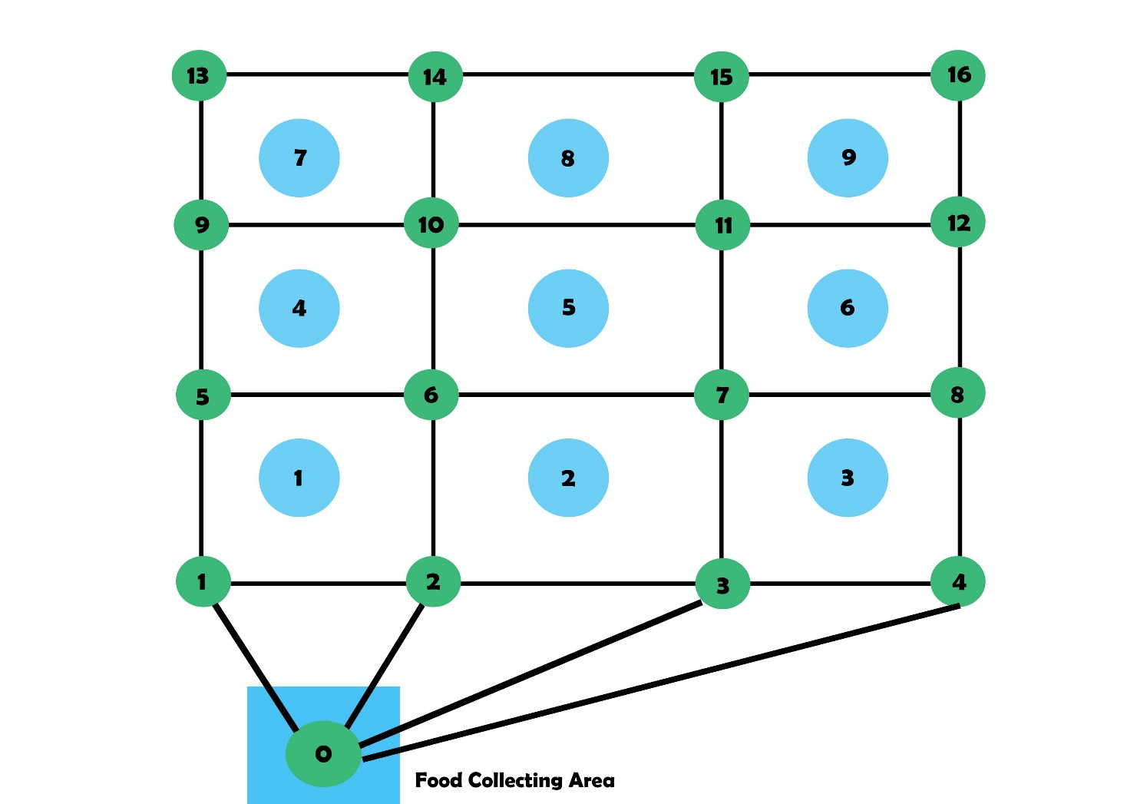
Idea for Path planning based on External camera

Slide 8
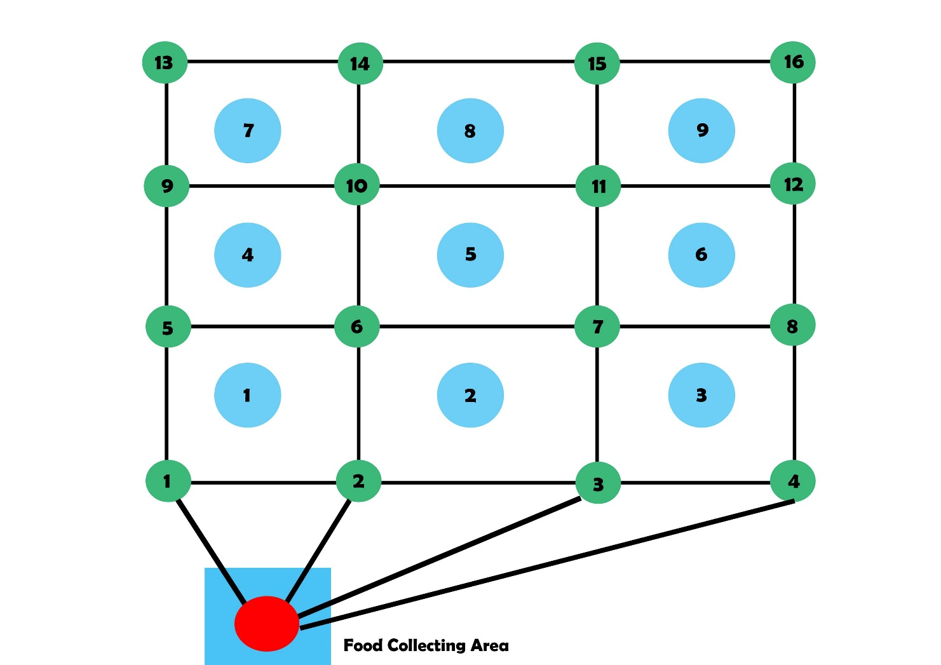
Idea for Path planning based on External camera

Slide 9
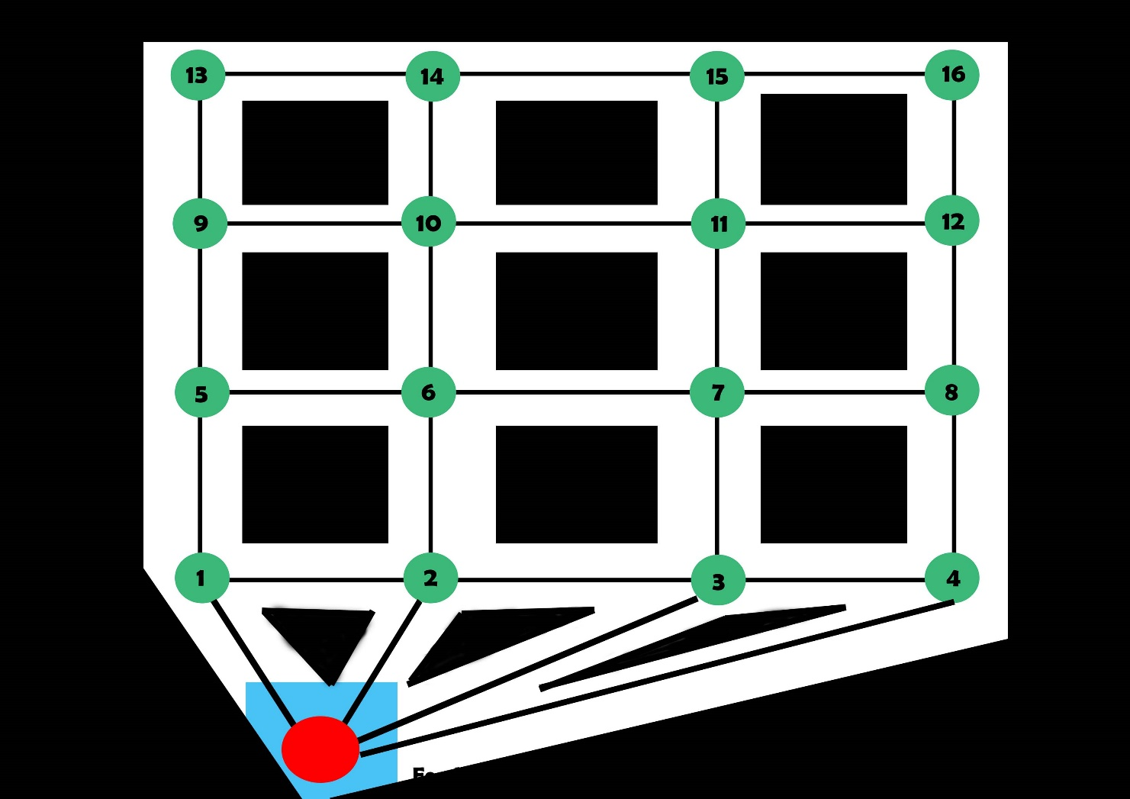
Idea for Path planning based on External camera

Slide 10
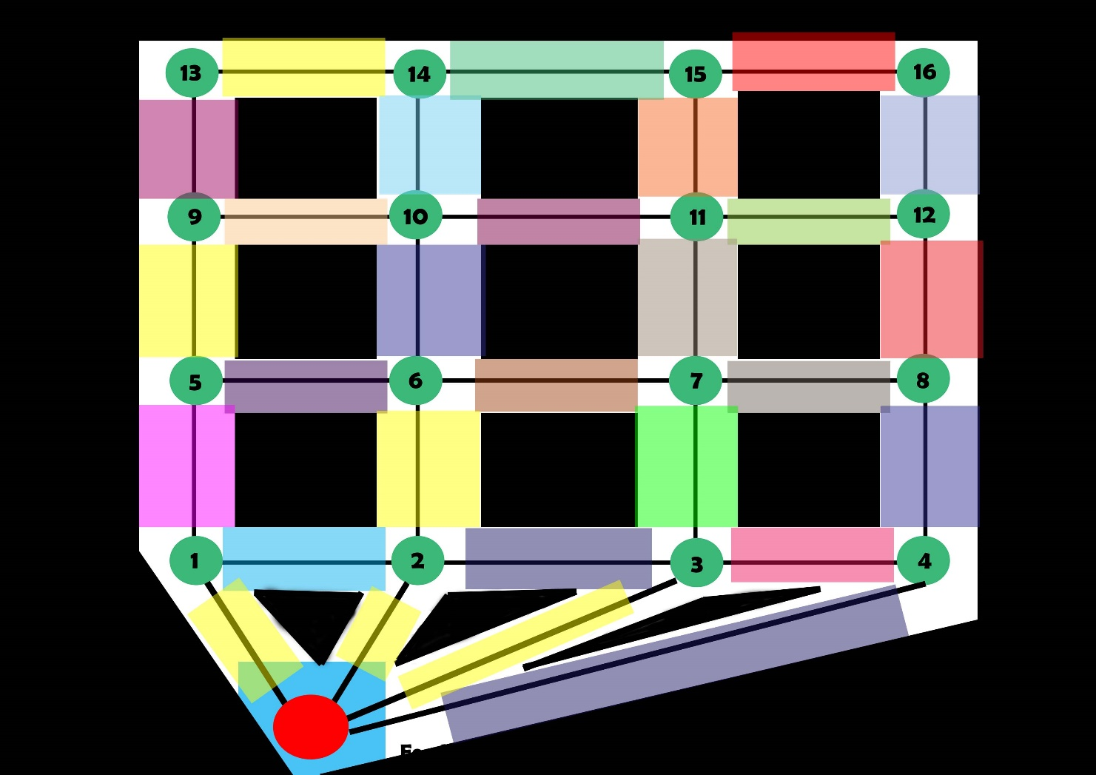
Idea for Path planning based on External camera

Slide 11
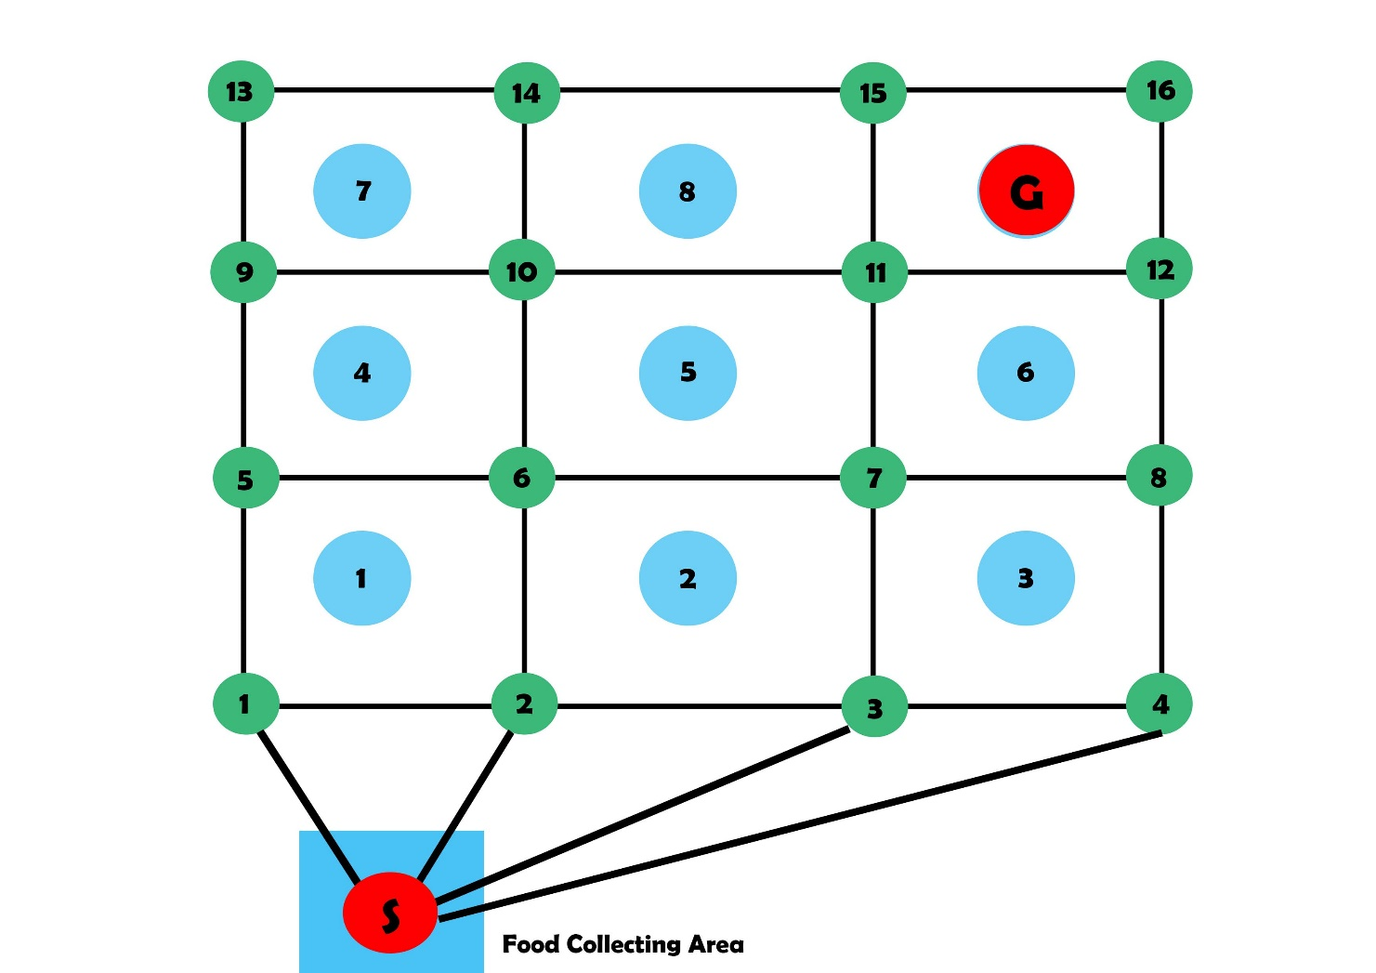
Idea for Path planning based on External camera

Slide 12
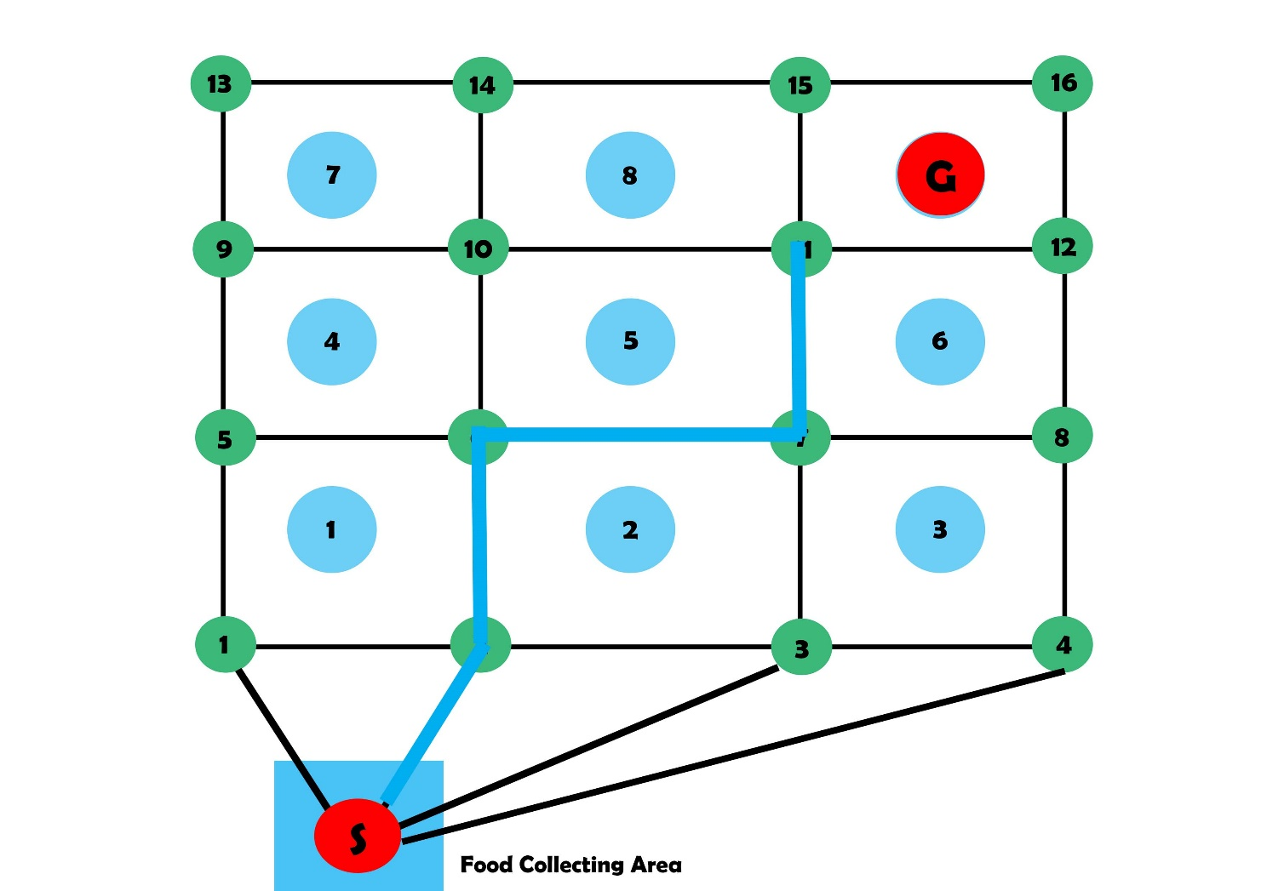
Idea for Path planning based on External camera

Slide 13
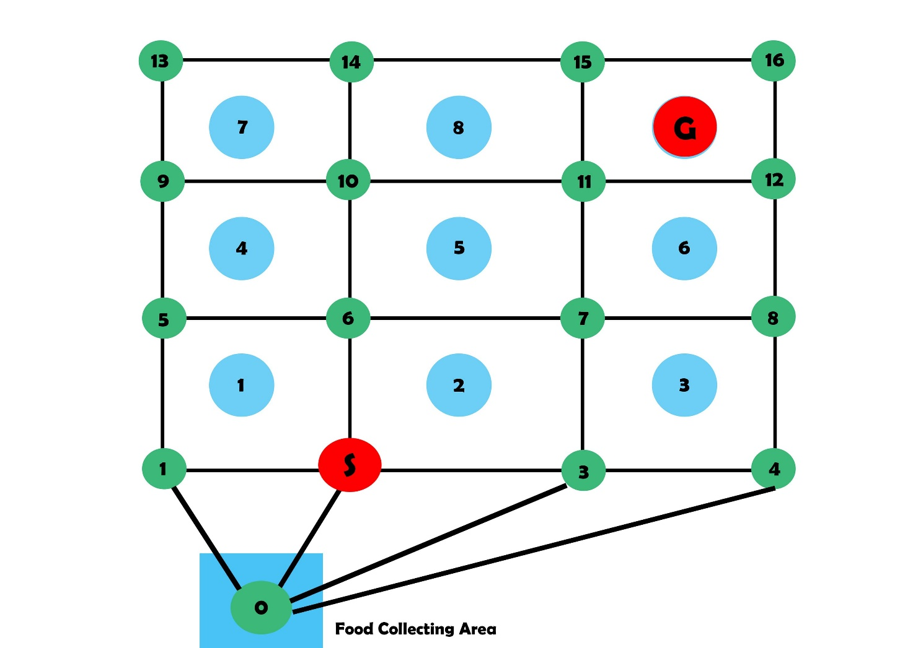
Idea for Path planning based on External camera

Slide 14

Idea for Path planning based on External camera

Slide 15
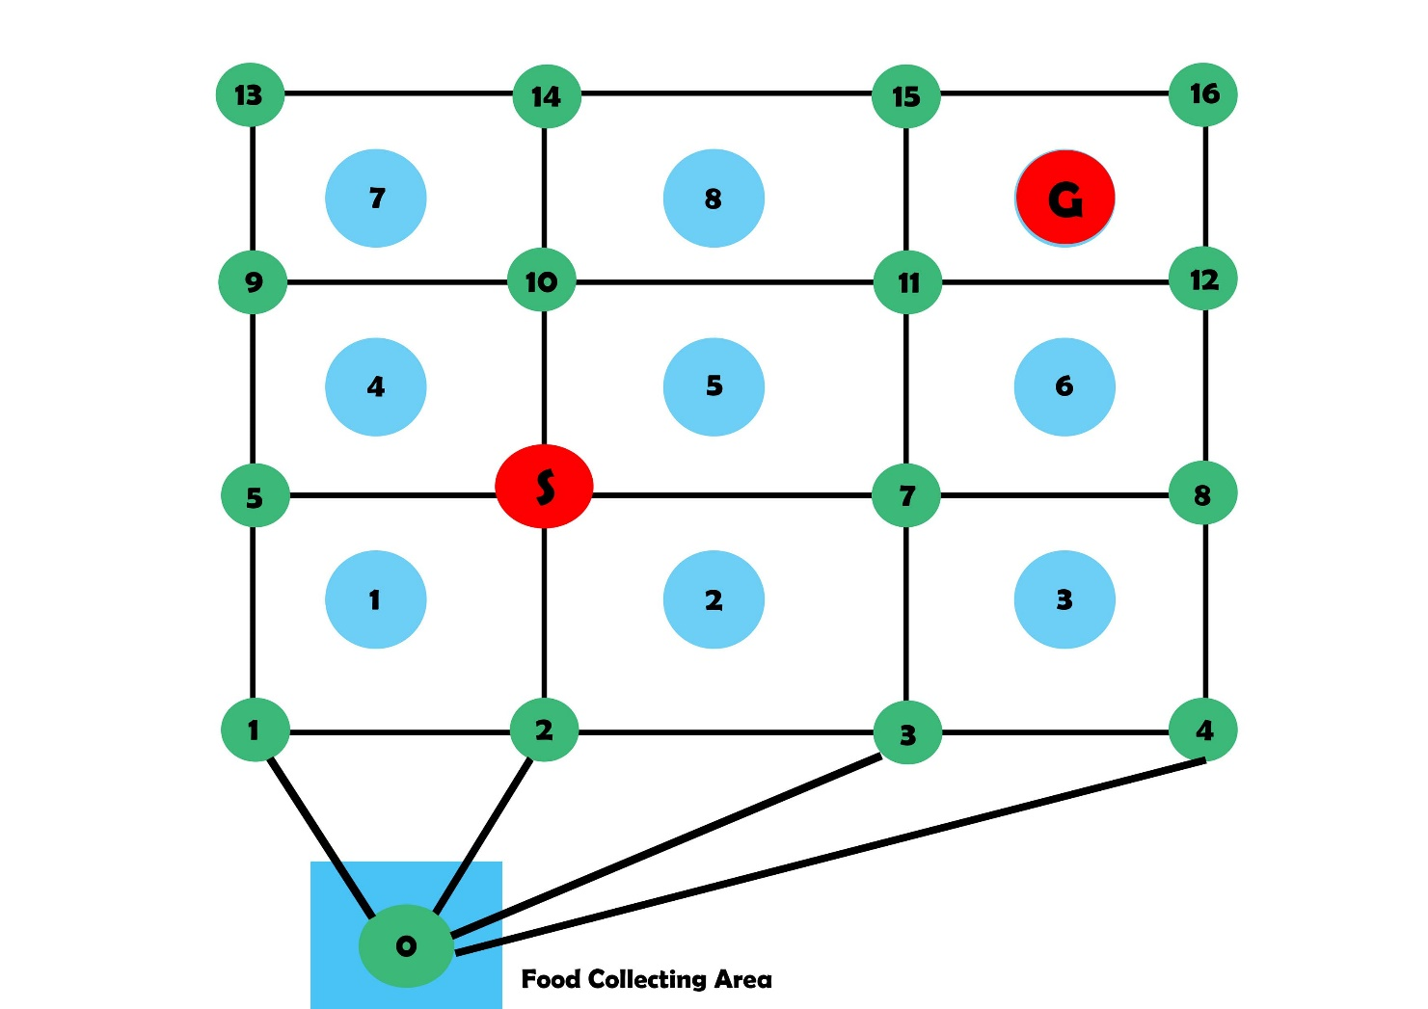
Idea for Path planning based on External camera

Slide 16
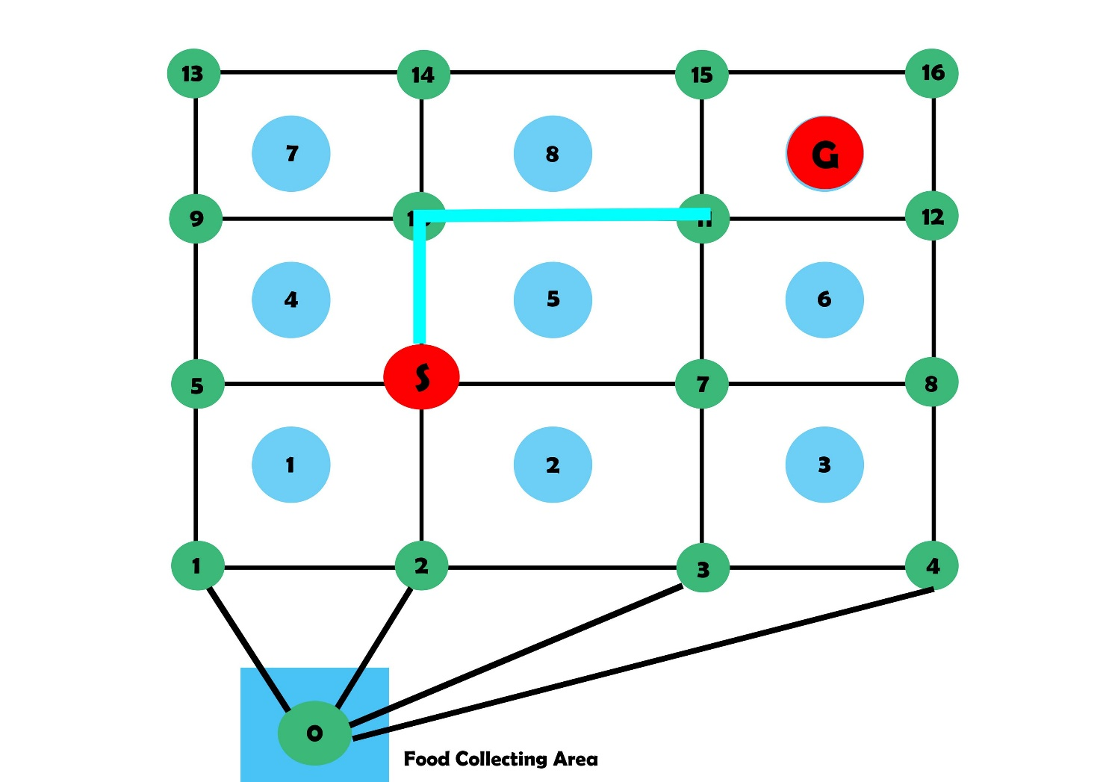
Idea for Path planning based on External camera

Slide 17
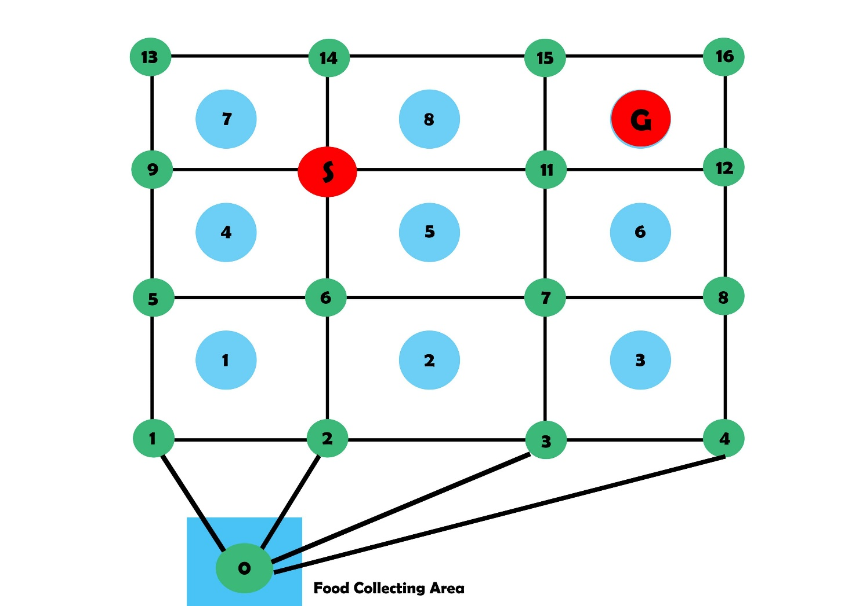
Idea for Path planning based on External camera

Slide 18
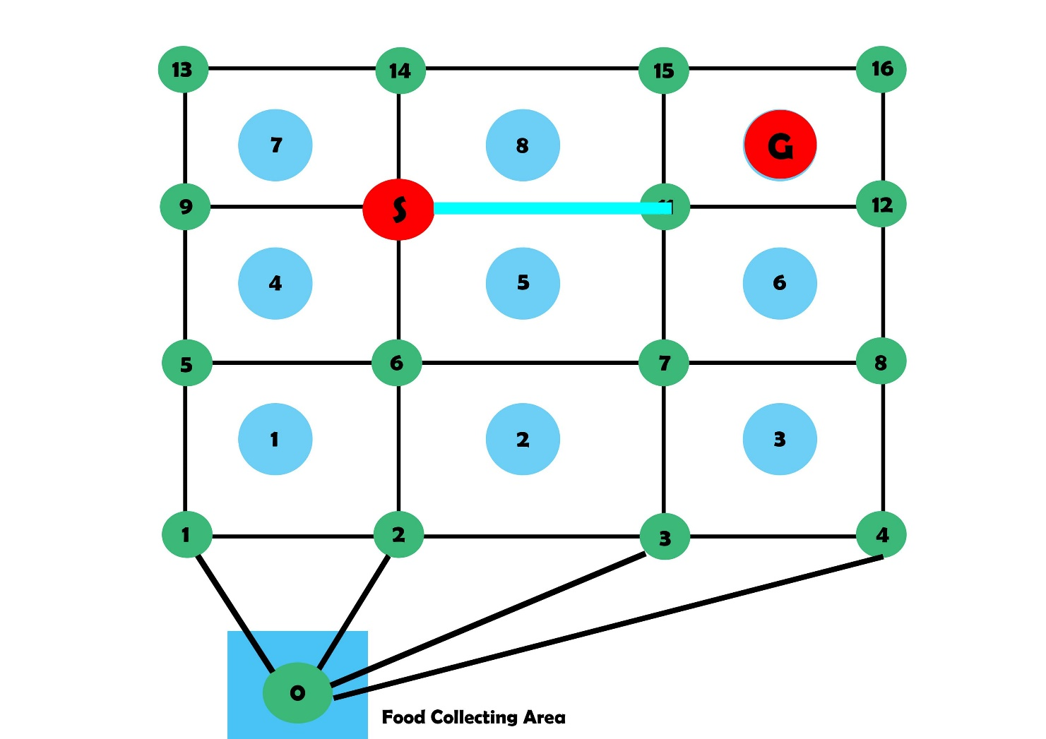
Idea for Path planning based on External camera

Slide 19
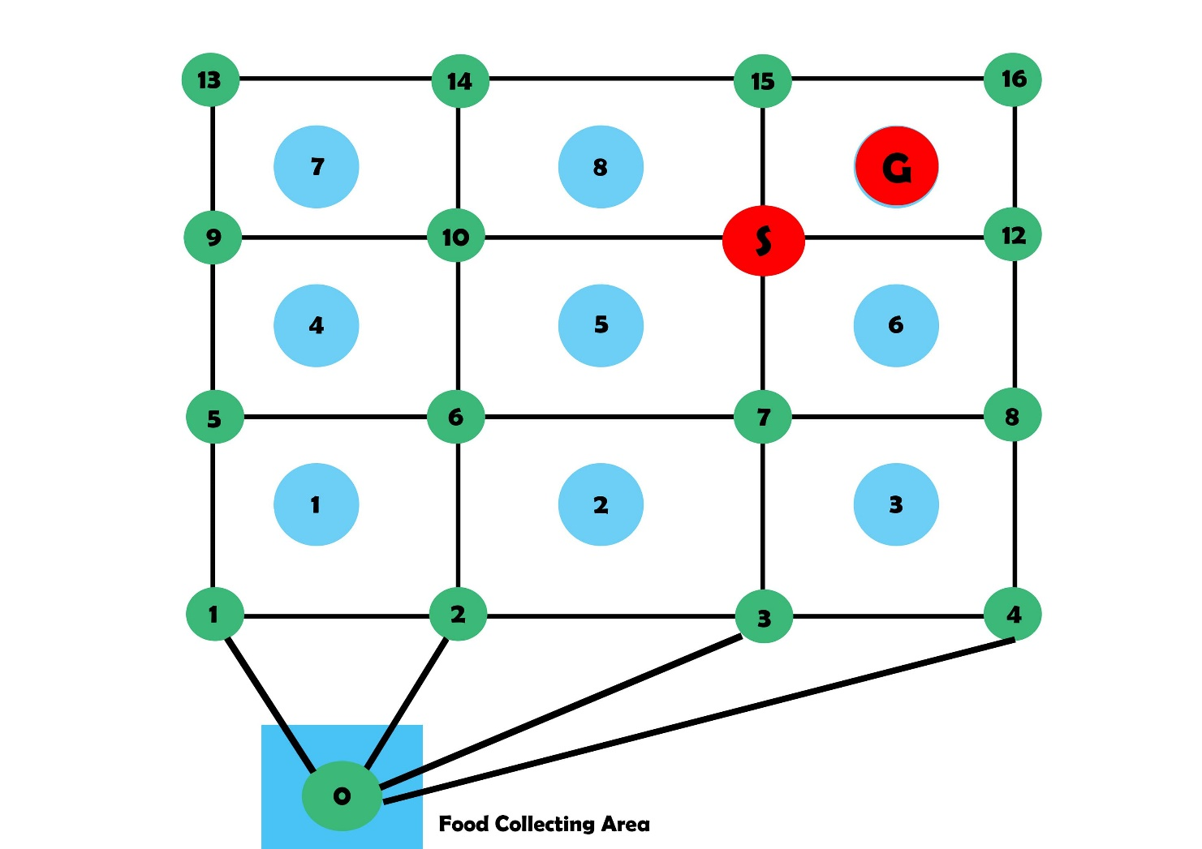
Idea for Path planning based on External camera

Slide 20
Mapping and Navigation with ROS
https://youtu.be/u9l-8LZC2Dc

Slide 21
For Next Week..
Buying items and start building the robot
Recording footages of canteen
Stitching images from multiple camera
Tracking moving objects on the path
Plotting the tracked objects to the map and do path planning for the robot
UI design and Database schema for Order management system
Implementation of the system on a local web server

Slide 22
Thank You

